Slide 1
SOP of Restoring Factory Settings for PMC-660
Feb, 2014

Slide 2
Preparation: Wire the Meter
Wire the power and the RS-485 port(COM1) of the meter
Connect the RS-485 port of the meter to your computer serial port
Power up the meter
Check the serial port number of your computer (for example, COM6)
Note down the communication parameters of COM1
For example, the default settings of COM1:
ID = 100
Baud Rate = 9600
Data Bits = 8
Configuration = 8E1
Protocol = Modbus

Slide 3
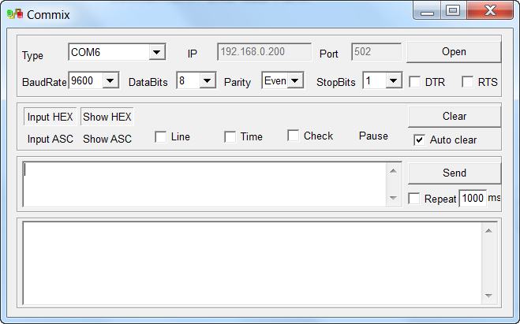
Setup Communication Parameters in Commix
Step 1: Run Commix. Setup the communication parameters (Type, Baud Rate, Data Bits, Parity, Stop Bits) and then click Open.

Slide 4
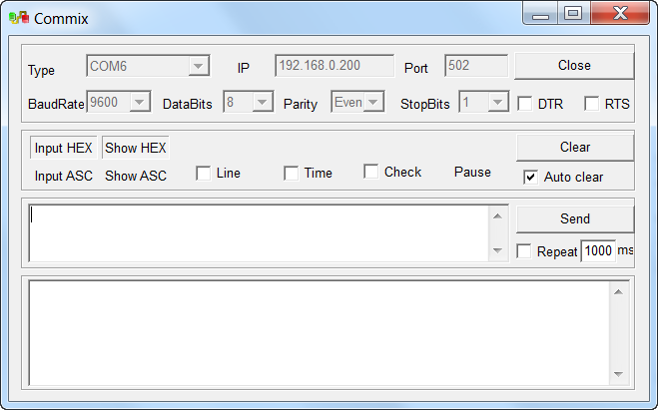
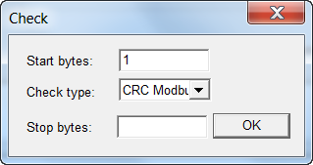
Setup Check Mode in Commix
Step 2: Click Check, then the Check dialog box appears, click OK.

Slide 5
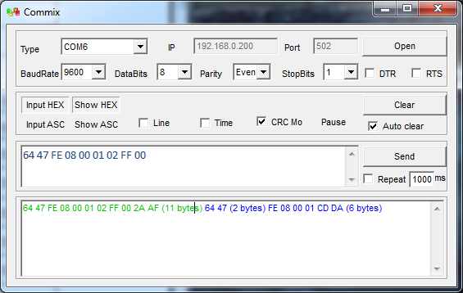
Restore Basic Setup Parameters
Step 3: Type 64 47 FE 08 00 01 02 FF 00 in the command area and click Send. If the command is sent successfully, the Request Packet(in green) and Response Packet(in blue) are both shown in the lower area. And the basic setup registers(address from 6000 – 6188) are restored.
Note: In the Request Packet, 64 is (Meter ID)_{Hex}, change it to match the meter ID.

Slide 6
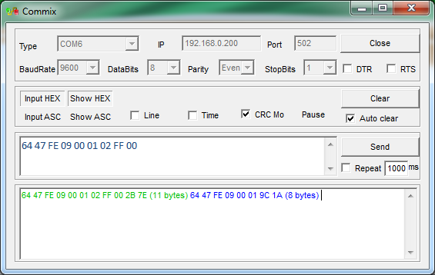
Restore Data Recorder Log Setup Parameters
Step 4: Type 64 47 FE 09 00 01 02 FF 00 in the command area and click Send. If the command is sent successfully, the Request Packet(in green) and Response Packet(in blue) are both shown in the lower area. And the data recorder log setup registers are restored.
Note: In the Request Packet, 64 is (Meter ID)_{Hex}, change it to match the meter ID.

Slide 7
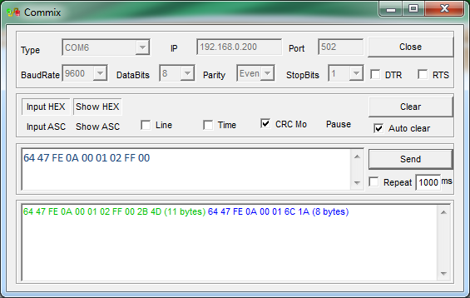
Restore Waveform Recorder Log Setup Parameters
Step 5: Type 64 47 FE 0A 00 01 02 FF 00 in the command area and click Send. If the command is sent successfully, the Request Packet(in green) and Response Packet(in blue) are both shown in the lower area. And the waveform recorder log setup registers are restored.
Note: In the Request Packet, 64 is (Meter ID)_{Hex}, change it to match the meter ID.

Slide 8
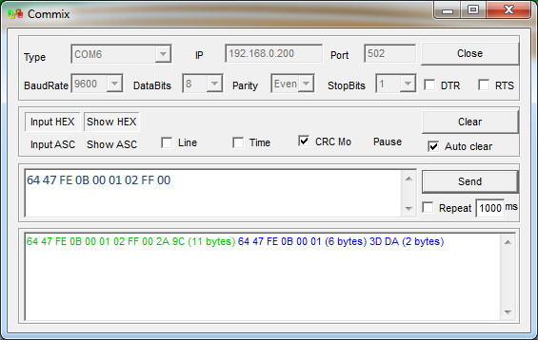
Restore Energy Log Setup Parameters
Step 6: Type 64 47 FE 0B 00 01 02 FF 00 in the command area and click Send. If the command is sent successfully, the Request Packet(in green) and Response Packet(in blue) are both shown in the lower area. And the energy log setup registers are restored.
Note: In the Request Packet, 64 is (Meter ID)_{Hex}, change it to match the meter ID.

Slide 9
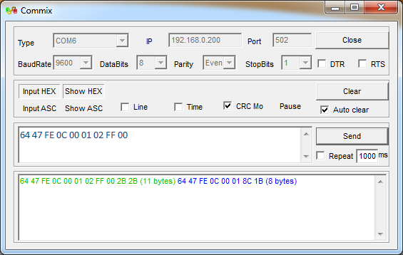
Restore Setpoint Setup Parameters
Step 7: Type 64 47 FE 0C 00 01 02 FF 00 in the command area and click Send. If the command is sent successfully, the Request Packet(in green) and Response Packet(in blue) are both shown in the lower area. And the setpoint setup registers are restored.
Note: In the Request Packet, 64 is (Meter ID)_{Hex}, change it to match the meter ID.

Slide 10
Thank You

